Slide 1
Vocations Sunday
3rd May 2020
“Good Shepherd Sunday”
A Virtual Assembly
Diocesan
Vocations
Office
Registered Charity 234216

Slide 2
Welcome to our assembly
As we can’t gather together, we’ve prepared this virtual assembly, so that hopefully young people from all the schools of our Archdiocese can still reflect and pray together.
There are some clips as part of this assembly, so you will need the sound turned up.
Let us begin this assembly with the Sign of the Cross:
In the name of the Father, and of the Son, and of the Holy Spirit. Amen.

Slide 3
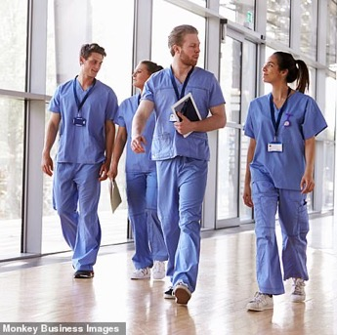
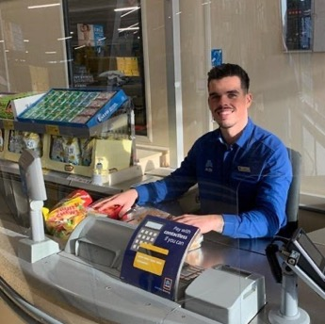
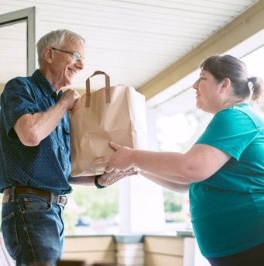
We all have a vocation
In the life of Church, most people are called to marriage or single life, and have other important vocations - serving God and serving others in their life, whether through their job, or in other ways they bring Jesus’ love to others.

Slide 4
The 4th Sunday of Easter
every year is
Vocations Sunday
or “Good Shepherd Sunday”
The readings are always about Jesus as our shepherd, who cares for us and guides us.
We pray for vocations in the Church.
We ask God to send us people who will be shepherds to care for us.

Slide 5
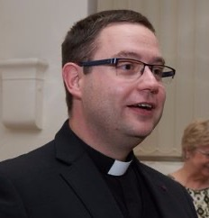
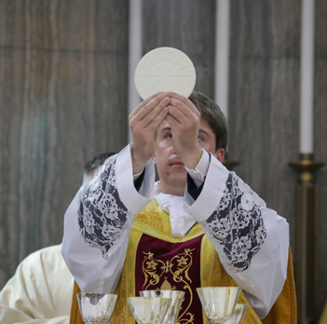
We pray especially for people to answer the call to vocations in the Church
Priests
These are men
whom God calls to
be shepherds for us
in the Church today.
          They bring Jesus to us by their teaching, by leading us and by sanctifying, especially through sacraments.

Slide 6
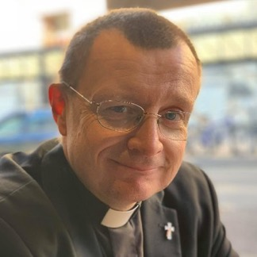
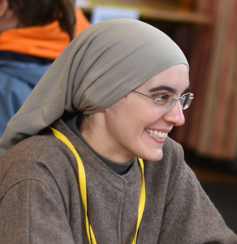
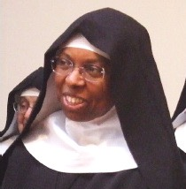
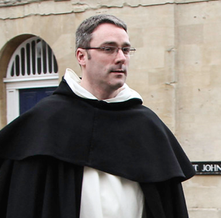
Deacons
These are men who
serve us by bringing
Jesus to us in the
sacraments, helping us understand God’s Word
and his love through charity.
Religious Brothers and Sisters
These are people who either help the Church in the community, or pray for us constantly.

Slide 7
Pope Francis has written a letter for Vocations Sunday 2020
          He asks us to reflect on the Gospel of Jesus calming the storm (Matthew 14:22-33).

Slide 8
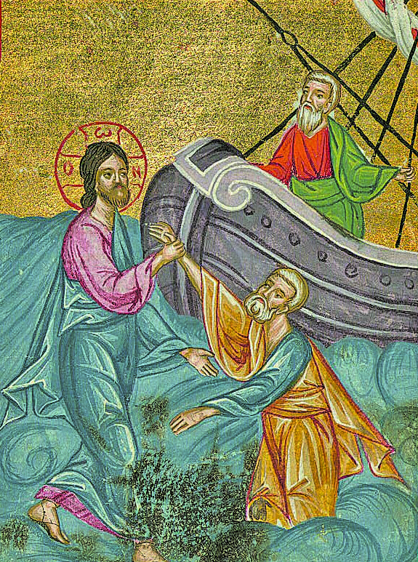

Let us listen to this Gospel being proclaimed
Click to listen

Slide 9
We reflect on how this
passage speaks to us today
Jesus himself makes time to pray to his Father.
Jesus tells the disciples to go to the other shore. Do I, in prayer, ask for help with the right way to go in life?
Jesus calls Peter to come to him. He invites us all to a relationship with him.
He holds out his hand to Peter. Jesus is with us to keep us safe.

Slide 10
Pope Francis wants us to remember 5 words when thinking about vocation:
Gratitude
Encouragement
Courage
Fatigue
Praise

Slide 11
Gratitude
Our vocation comes from Jesus’ love for us, which we perhaps realise in stormy times.
We show gratitude – we thank Jesus for his call to us.
Encouragement
The disciples see Jesus on the water. The think he’s a ghost and are filled with fear.
Jesus gives encouragement that we can use on our vocational journey in life: “Take heart, it is I; have no fear.”

Slide 12
Courage
We can find it difficult to say “yes” to Jesus, but he knows the questions, doubts and fears in our heart.
We can have courage, knowing Jesus is by our side, remembering “Take heart, it is I; have no fear.”
Fatigue
All vocations come with responsibilities, which can be difficult.
When fatigue or tiredness makes us start to sink, Jesus helps us, like he helped Peter walk on water.

Slide 13
Praise
When Jesus boards the boat, the winds die down.
Jesus is stretching his hand our to us always - take it!
Even in stormy times we must praise God for the wonderful things he does for us.
In your prayers, ask that that you
will encourage others in their vocation and that all of us will gratefully discover God’s call - to find the courage to say “yes”, to overcome all fatigue and to make our lives a song of praise to God.

Slide 14
Prayer for Vocations Sunday 2020
Click to join in with the prayer
Continue to send labourers into your harvest.
Inspire the hearts of your people
to answer your call to the priesthood, the diaconate
and to the religious life.
Send your Holy Spirit upon me
to guide me in my own vocation.
Enlighten my mind to show me what you want of me;
fill my heart with the determination
to answer your call in faith, hope and love.
Through Jesus Christ, our Lord.
Amen.
In the name of the Father, and of the Son, and of the Holy Spirit. Amen.
Heavenly Father,
we thank you for the witness and ministry
of the bishops, priests and deacons
and consecrated men and women
in the Archdiocese of Birmingham.
Bless our families
with a spirit of generosity
and may those you call have the courage
to give themselves to your Church in faith.

